Slide 1
Updates
3.25.2015

Slide 2
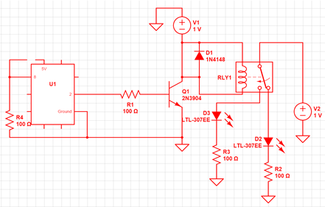
Lotanna
This Week
Implement circuit that controls relay with the Arduino
Schematic:

Slide 3
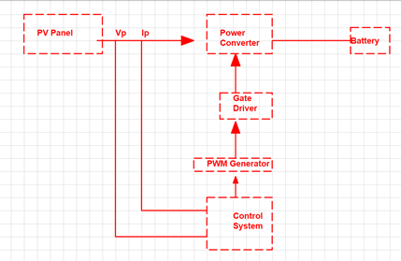
Lotanna (cont.d)
Next Week
Brief Overview
Schematic:
PV Panel
Solar Panels
Power Converter
Power MOSFET in Buck DC-DC Converter configuration. Controls the output current to the battery
Control System
Arduino- sensing voltage and current from PV panels and determining when battery stops charging
PWM Generator
Generate the pulse width depending on duty cycle given from control system
Gate Driver
Sends strong enough signal from the generator to converter
Deliverables:
Confirm appropriate parts selection and purchase components??

